Slide 1
Exception HANDLING. LOGGING. NLOG
.NET & JS Lab, RD belarus
Anzhelika Kravchuk

Slide 2
Module Overview
Raising Exceptions
Handling Exceptions

Slide 3
What Is an Exception?
An exception is an event, which occurs during the execution of a program, that disrupts the normal flow of the program's instructions.

Slide 4
Causes of Exceptions
Code defects, such as forgetting null checks causing NullReferenceExceptions or passing invalid arguments to some method that signals the defect using an ArgumentException or variation thereof.
int[] numbers = new[] { 2, 3, 5, 7 };
for (int i = 0; i <= numbers.Length; i++)
{
Console.WriteLine(numbers[i]);
}
IndexOutOfRangeException
FormatException
Console.Write("What’s your age ?");
string age = Console.ReadLine();
int yearOfBirth = DateTime.Now.Year - int.Parse(age);
Console.WriteLine($"I bet you were born around {yearOfBirth}.");

Slide 5
Causes of Exceptions
Console.Write("What’s your age?");
string age = Console.ReadLine();
try
{
int yearOfBirth = DateTime.Now.Year - int.Parse(age);
Console.WriteLine($"I bet you were born around {yearOfBirth}.");
}
catch (FormatException)
{
Console.WriteLine($"Invalid {nameof(age)} specified.");
}
versus
Console.Write("What’s your age?");
string ageString = Console.ReadLine();
int age;
if (int.TryParse(ageString, out age))
{
int yearOfBirth = DateTime.Now.Year - age;
Console.WriteLine($"I bet you were born around {yearOfBirth}.");
}

Slide 6
Causes of Exceptions
Runtime disasters that prevent the CLR’s execution engine from continuing execution; for example, due to insufficient memory (OutOfMemoryException) or a stack overflow.
static void Main()
{
Main();
}
StackOverflowException

Slide 7
Causes of Exceptions
Error conditions in the environment where the code is operating, such as a missing configuration file, failure to connect to a web service or a database, or an external component failing.
static void PrintFile(string path)
{
foreach (string line in File.ReadAllLines(path))
{
Console.WriteLine(line);
}
}
FileNotFoundException
if (!File.Exists(path))
{
// Handle the problematic situation.
}

Slide 8
Searching the call stack for the exception handler

Slide 9
What Is an Exception?
Exception
Main
A
B
C

Slide 10
The System.Exception Class
Property | Description
Data | A reference to a collection of key-value pairs. Usually, the code throwing the exception adds entries to this collection prior to throwing it; code that catches the exception can query the entries and use the information in its exception-recovery processing.
HelpLink | Contains a URL (such as le://C:\MyApp\Help.htm #MyExceptionHelp) to documentation that can help a user understand the exception. Keep in mind that sound programming and security practices prevent users from ever being able to see raw unhandled exceptions, so unless you are trying to convey information to other programmers, this property is seldom used.
InnerException | Indicates the previous exception if the current exception were raised while handling an exception. This read-only property is usually null. The Exception type also offers a public GetBaseException method that traverses the linked list of inner exceptions and returns the originally thrown exception.
Message | Contains helpful text indicating why the exception was thrown. The message is typically written to a log when a thrown exception is unhandled. Because end users do not see this message, the message should be as technical as possible so that developers viewing the log can use the information in the message to x the code when producing a new version.
Source | Contains the name of the assembly that generated the exception.
StackTrace | Contains the names and signatures of methods called that led up to the exception being thrown. This property is invaluable for debugging.
Targetsite | Contains the method that threw the exception.

Slide 11
Exception Classes in C#
Exception Class | Description
System.IO.IOException | Handles I/O errors.
System.IndexOutOfRangeException | Handles errors generated when a method refers to an array index out of range.
System.ArrayTypeMismatchException | Handles errors generated when type is mismatched with the array type.
System.NullReferenceException | Handles errors generated from referencing a null object.
System.DivideByZeroException | Handles errors generated from dividing a dividend with zero.
System.InvalidCastException | Handles errors generated during typecasting.
System.OutOfMemoryException | Handles errors generated from insufficient free memory.
System.StackOverflowException | Handles errors generated from stack overflow.

Slide 12
Throwing Exceptions
void DisplayUserProfile(string user)
{
if (user == null)
throw new ArgumentNullException(nameof(user));
if (string.IsNullOrEmpty(user))
throw new ArgumentException("exception");
if (!Profiles.Exists(user))
throw new UserNotFoundException(nameof(user));
// Do real work here.
}
A program throws an exception when a problem shows up. This is done using a throw keyword

Slide 13
Handling Exceptions
A try block identifies a block of code for which particular exceptions is activated
try
{
[Try block.]
}
catch ([catch specification 1])
{
[Catch block 1.]
}
...
catch ([catch specification n])
{
[Catch block n.]
}
A program catches an exception with an exception handler at the place in a program where you want to handle the problem. The catch keyword indicates the catching of an exception

Slide 14
Handling Exceptions
try
{
// Try block.
}
catch
{
// Catch block.
}
The most common kind of catch block that does not have a catch specification, and therefore intercepts any type of exception
try
{
// Try block.
}
catch (Exception ex)
{
// Catch block, can access exception in ex.
}
The Exception type is often used to catch all exceptions that have not been otherwise processed

Slide 15
Handling Exceptions
Logic that might cause an exception
try
{
// Try block.
}
catch (DivideByZeroException ex)
{
// Catch block, can access DivideByZeroException
// exception in ex.
}
catch (Exception ex)
{
// Catch block, can access exception in ex.
}
Logic to run in the event of a DivideByZeroException exception
Logic to run in the event of any other exceptions
DivideByZeroException
ArithmeticException
OverflowException
NotFiniteNumberException

Slide 16
Handling Exceptions
try
{
// Outer try block.
...
try
{
// Nested try block
}
catch (FileNotFoundException ex)
{
// Catch block for nested try block
}
...
// Outer try block continued
}
catch (DivideByZeroException ex)
{
// Catch block, can access DivideByZeroException exception in ex.
}
catch (Exception ex)
{
// Catch block, can access exception in ex.
}
You can also nest try/catch blocks

Slide 17
Handling Exceptions
try
{
[Try block.]
}
catch ([catch specification 1])
{
[Catch block 1.]
}
...
catch ([catch specification n])
{
[Catch block n.]
}
finally
{
[Finally block.]
}
The finally block is used to execute a given set of statements, whether an exception is thrown or not thrown. For example, if you open a file, it must be closed whether an exception is raised or not.

Slide 18
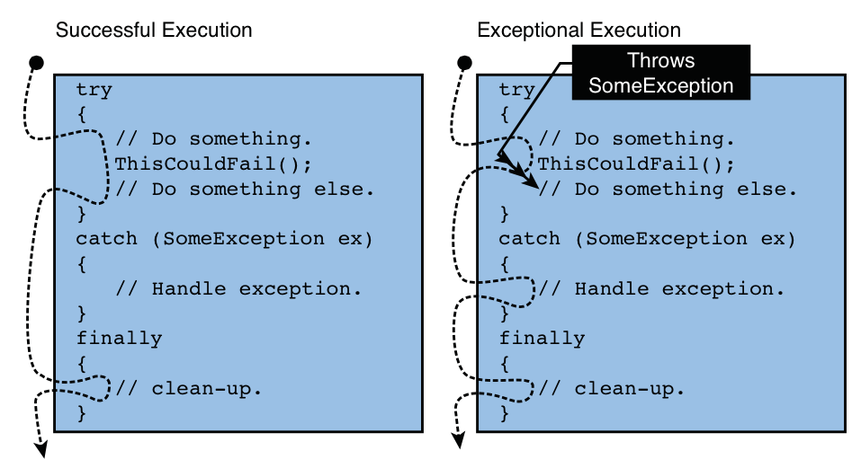
Handling Exceptions

Slide 19
Using the Checked and Unchecked Keywords
C# applications run with integer numeric overflow checking disabled by default. You can change this project setting
You can control overflow checking for specific code by using the checked and unchecked keywords
checked and unchecked blocks
checked
{
int x = ...;
int y = ...;
int z = ...;
...
}
unchecked
{
int x = ...;
int y = ...;
int z = ...;
...
}
checked and unchecked operators
...
int z = checked(x* y);
...
...
int z = unchecked(x* y);
...

Slide 20
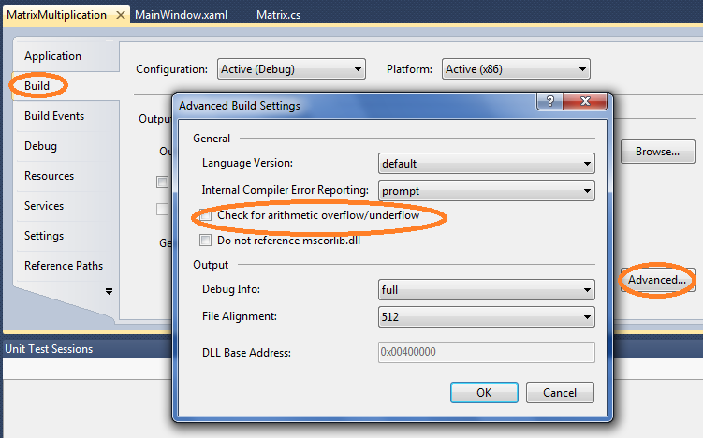
Using the Checked and Unchecked Keywords

Slide 21
Guidelines and Best Practices
Check methods arguments
static void CopyObject(SampleClass original)
{
if (original == null)
{
throw new ArgumentNullException(nameof(original));
}
}
System.ArgumentException
System.ArgumentNullException
System.ArgumentOutOfRangeException
System.DuplicateWaitObjectException

Slide 22
Guidelines and Best Practices
Use finally Blocks Liberally
public void SomeMethod()
{
FileStream fs = new FileStream(@"C:\Data.bin ", FileMode.Open);
try
{
// Outputing the quotient from the division of 100 by the first byte
// of the file
Console.WriteLine(100 / fs.ReadByte());
}
finally
{
// In finally block clearing code is situated, guaranteeing
// closure of the file independently from the occurrence of the
// exception (for example if the first byte is 0) or not.
if (fs != null) fs.Dispose();
}
}

Slide 23
Guidelines and Best Practices
The C# language automatically emits try/finally blocks whenever you use the lock, using, and foreach statements. The C# compiler also emits try/finally blocks whenever you override a class’s destructor (the Finalize method). When using these constructs, the compiler puts the code you’ve written inside the try block and automatically puts the cleanup code inside the finally block. Specically:
When you use the lock statement, the lock is released inside a finally block.
When you use the using statement, the object has its Dispose method called inside a
finally block.
When you use the foreach statement, the IEnumerator object has its Dispose method
called inside a finally block.
When you de ne a destructor method, the base class’s Finalize method is called inside a
finally block.

Slide 24
Guidelines and Best Practices
private void SomeMethod()
{
using (FileStream fs = new FileStream(@"C:\Data.bin", FileMode.Open))
{
// Display 100 divided by the first byte in the file.
Console.WriteLine(100 / fs.ReadByte());
}
}

Slide 25
Guidelines and Best Practices
Don’t Catch Everything
try
{
// try to execute code that the programmer knows might fail...
}
catch (Exception)
{
// rethrow!
}

Slide 26
Guidelines and Best Practices
Recovering Gracefully from an Exception
public String CalculateSpreadsheetCell(int row, int column)
{
string result;
try
{
result = /* Code for calculating the value of a spreadsheet cell */
}
catch (DivideByZeroException)
{
result = "Can't show value: Divide by zero";
}
catch (OverflowException)
{
result = "Can't show value: Too big";
}
return result;
}

Slide 27
Guidelines and Best Practices
Backing Out of a Partially Completed Operation When an Unrecoverable Exception Occurs—Maintaining State
public void SerializeObjectGraph(FileStream fs, IFormatter formatter, object rootObj)
{
// Save current position to file
long beforeSerialization = fs.Position;
try
{
// Try to serialize an object graph and write it to file.
formatter.Serialize(fs, rootObj);
}
catch
{
// Catching every single exception.
// With ANY deviation bring the file back to normal state.
fs.Position = beforeSerialization;
// Truncate the file.
fs.SetLength(fs.Position);
// SIDENOTE: previous code is’t placed into the finally block,
// thread flush is needed only if serialization fails.
// Notify the calling code about what happened,
// By generating the SAME EXCEPTION again.
throw;
}
}

Slide 28
Guidelines and Best Practices
Hiding an Implementation Detail to Maintain a “Contract”
internal sealed class PhoneBook
{
private string pathname; // Path to the file with telephone directory.
// The other methods are here.
public string GetPhoneNumber(string name)
{
string phone;
FileStream fs = null;
try
{
fs = new FileStream(pathname, FileMode.Open);
// Code for reading from fs, while the number won’t be found
phone = /* phone number is found */
}

Slide 29
Guidelines and Best Practices
catch (FileNotFoundException e)
{
// Generate another exception with the name of the subscriber
// setting the initial exception as the internal exception of
// the new one.
throw new NameNotFoundException(name, e);
}
catch (IOException e)
{
// Generate another exception with the name of the subscriber
// setting the initial exception as the internal exception of
// the new one.
throw new NameNotFoundException(name, e);
}
finally
{
if (fs != null) fs.Close();
}
return phone;
}
}

Slide 30



Guidelines and Best Practices
PL
BLL
DAL
Presentation Layer
Business-Logic
Layer
Data Access Layer

Slide 31
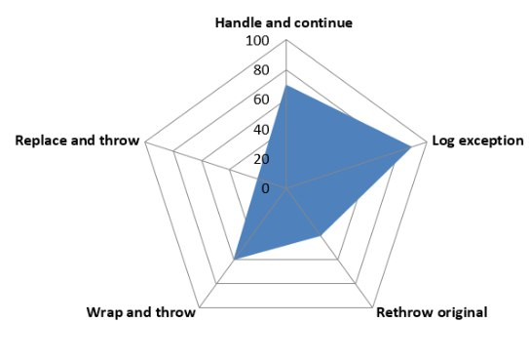
Guidelines and Best Practices

Slide 32
Best Practices for
Use the standard event signature
Use a protected virtual method to raise an event
Do not pass null to an event
Notes:
Explain the best practice for using events:
Use the standard event signature:
Highlight how using a standard signature makes using events easier for all developers.
Remind students of the standard event signature: void name (object sender, EventArgs e).
Use a protected virtual method to raise an event:
Explain the benefits of using a protected virtual method—it can be overridden in child classes if necessary.
Explain the standard for using the word On before the event name for methods that raise events.
Explain that the On method signature should match the signature of the event.
Explain that using a method to raise an event can reduce code duplication—use the standard check for null as an example.
Do not pass null to an event:
Explain that students should avoid passing null as a parameter when they raise an event. In particular, they should always pass the this keyword as the first parameter.

